Slide 1


Slide 2
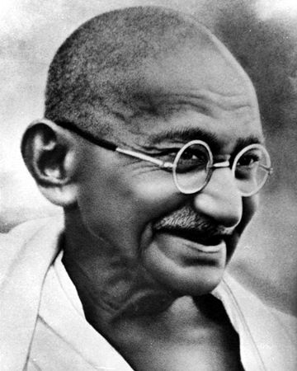
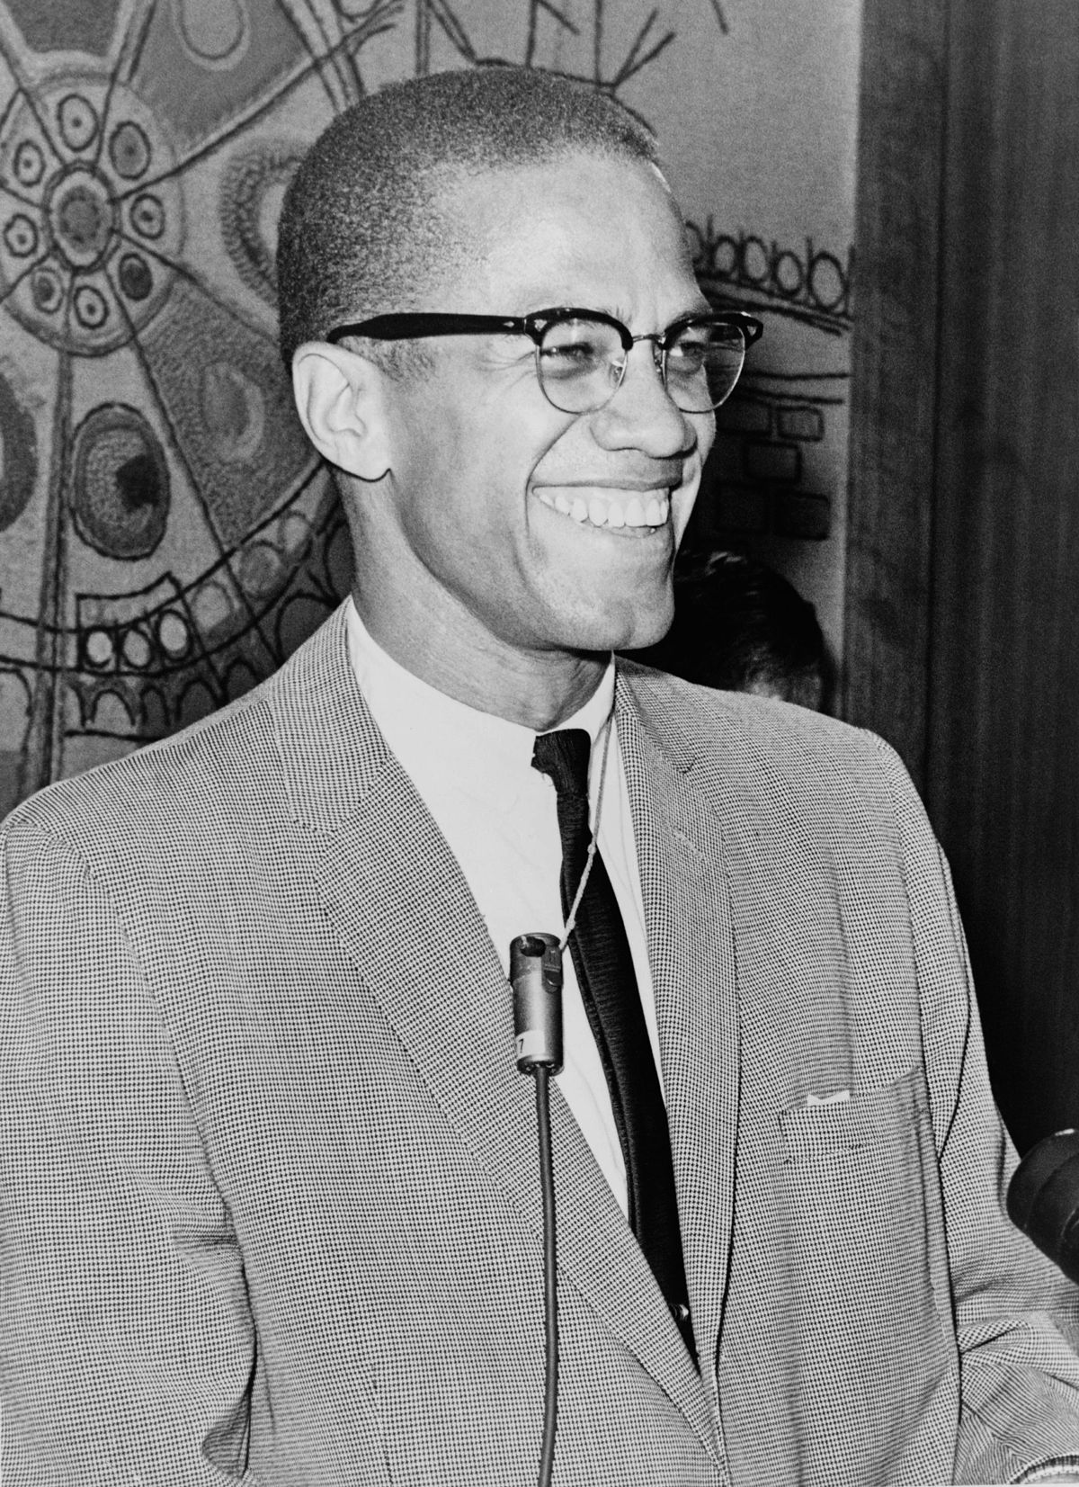
“The future depends on what you do today.”
Mahatma Gandhi
“The future belongs to those who prepare for it today.”
Malcolm X

Slide 3
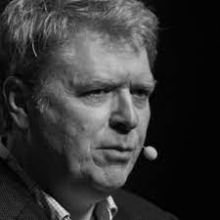
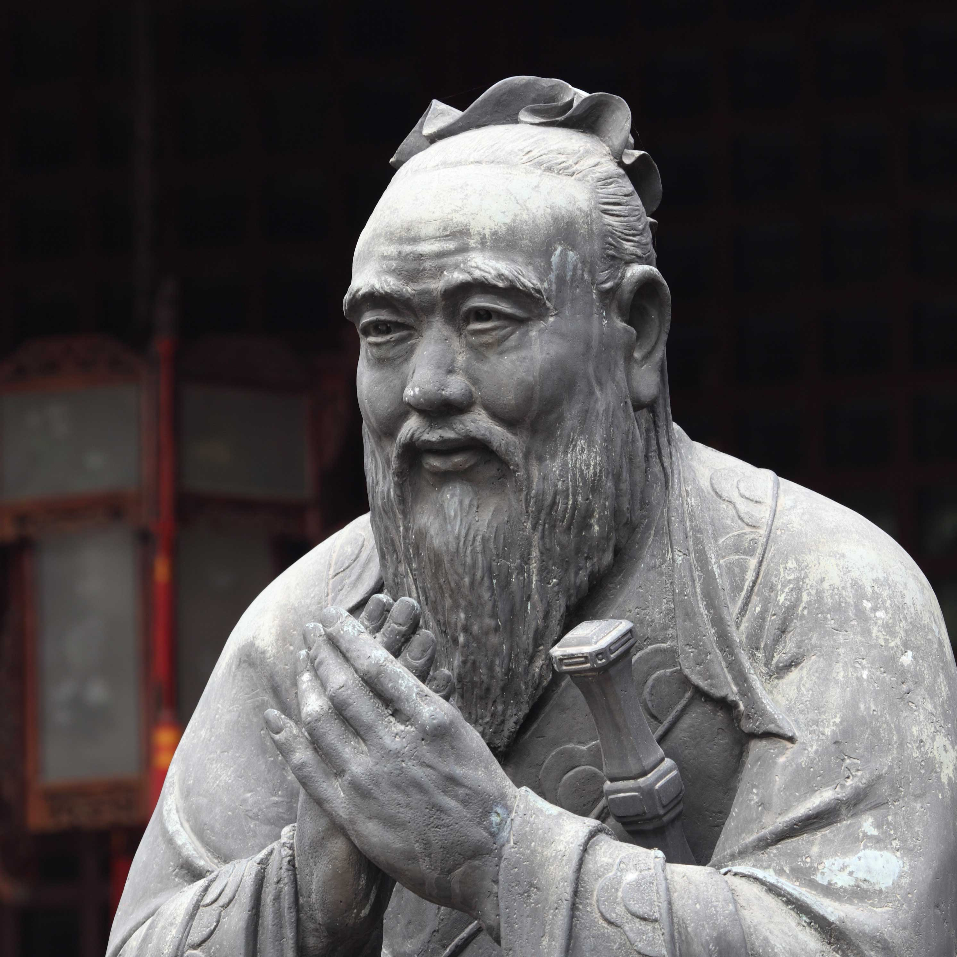
“Developers have to steep themselves in the domain to build up knowledge of the business”
Eric Evans
“It does not matter how slowly you go, so long as you do not stop.”
Confucius

Slide 4
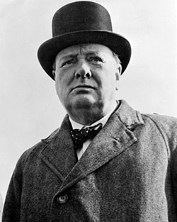
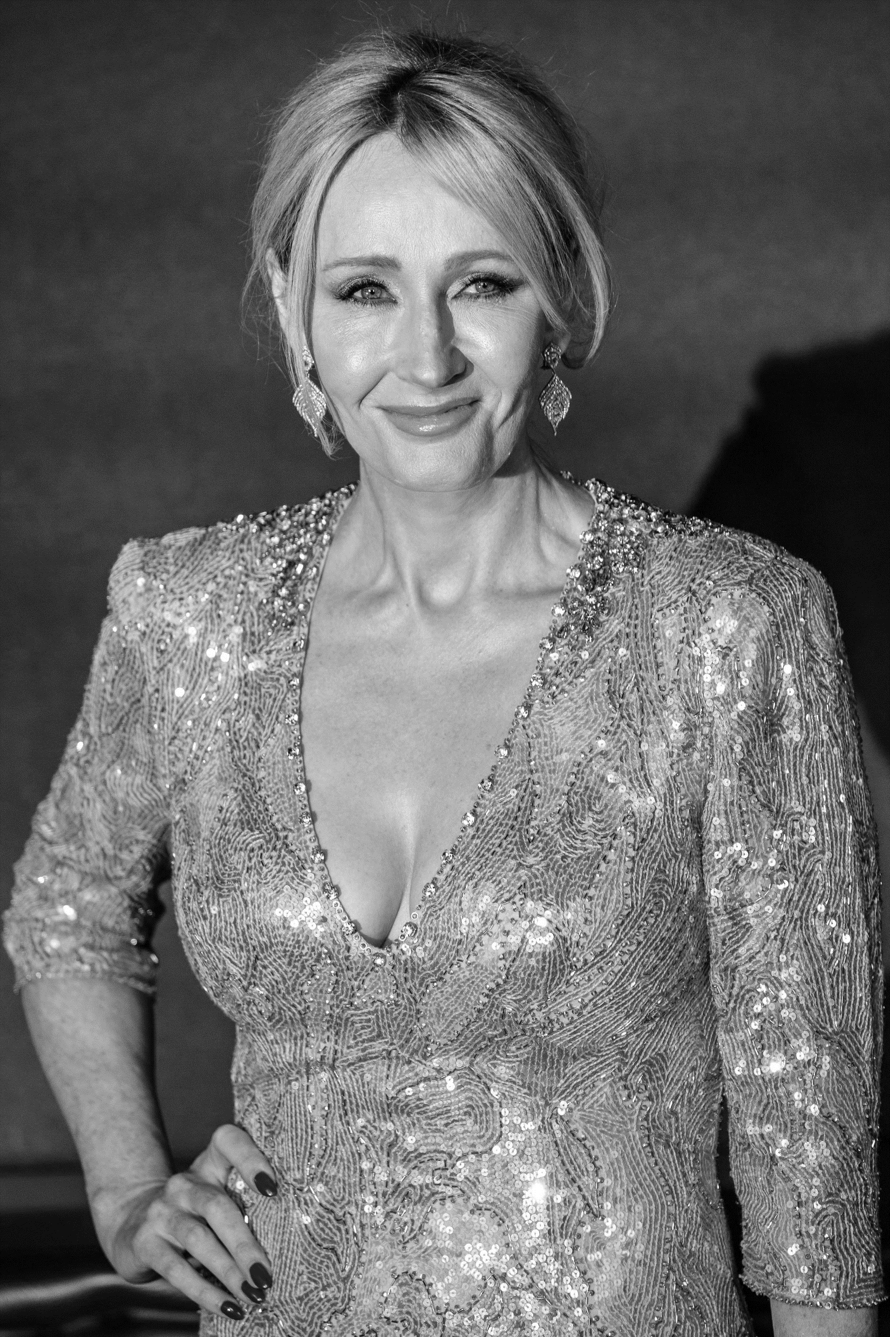
“We shape our buildings; thereafter they shape us.”
Winston Churchill
“It matters not what someone is born, but what they grow to be.”
J. K. Rowling

Slide 5
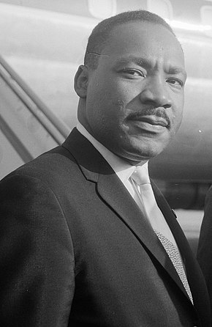
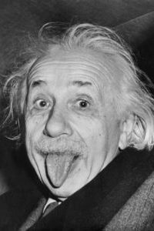
“There is an almost universal quest for easy answers and half-baked solutions.”
Martin Luther King
“If the facts don’t fit the theory, change the facts.”
Albert Einstein

Slide 6
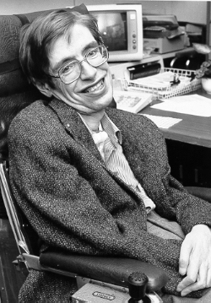
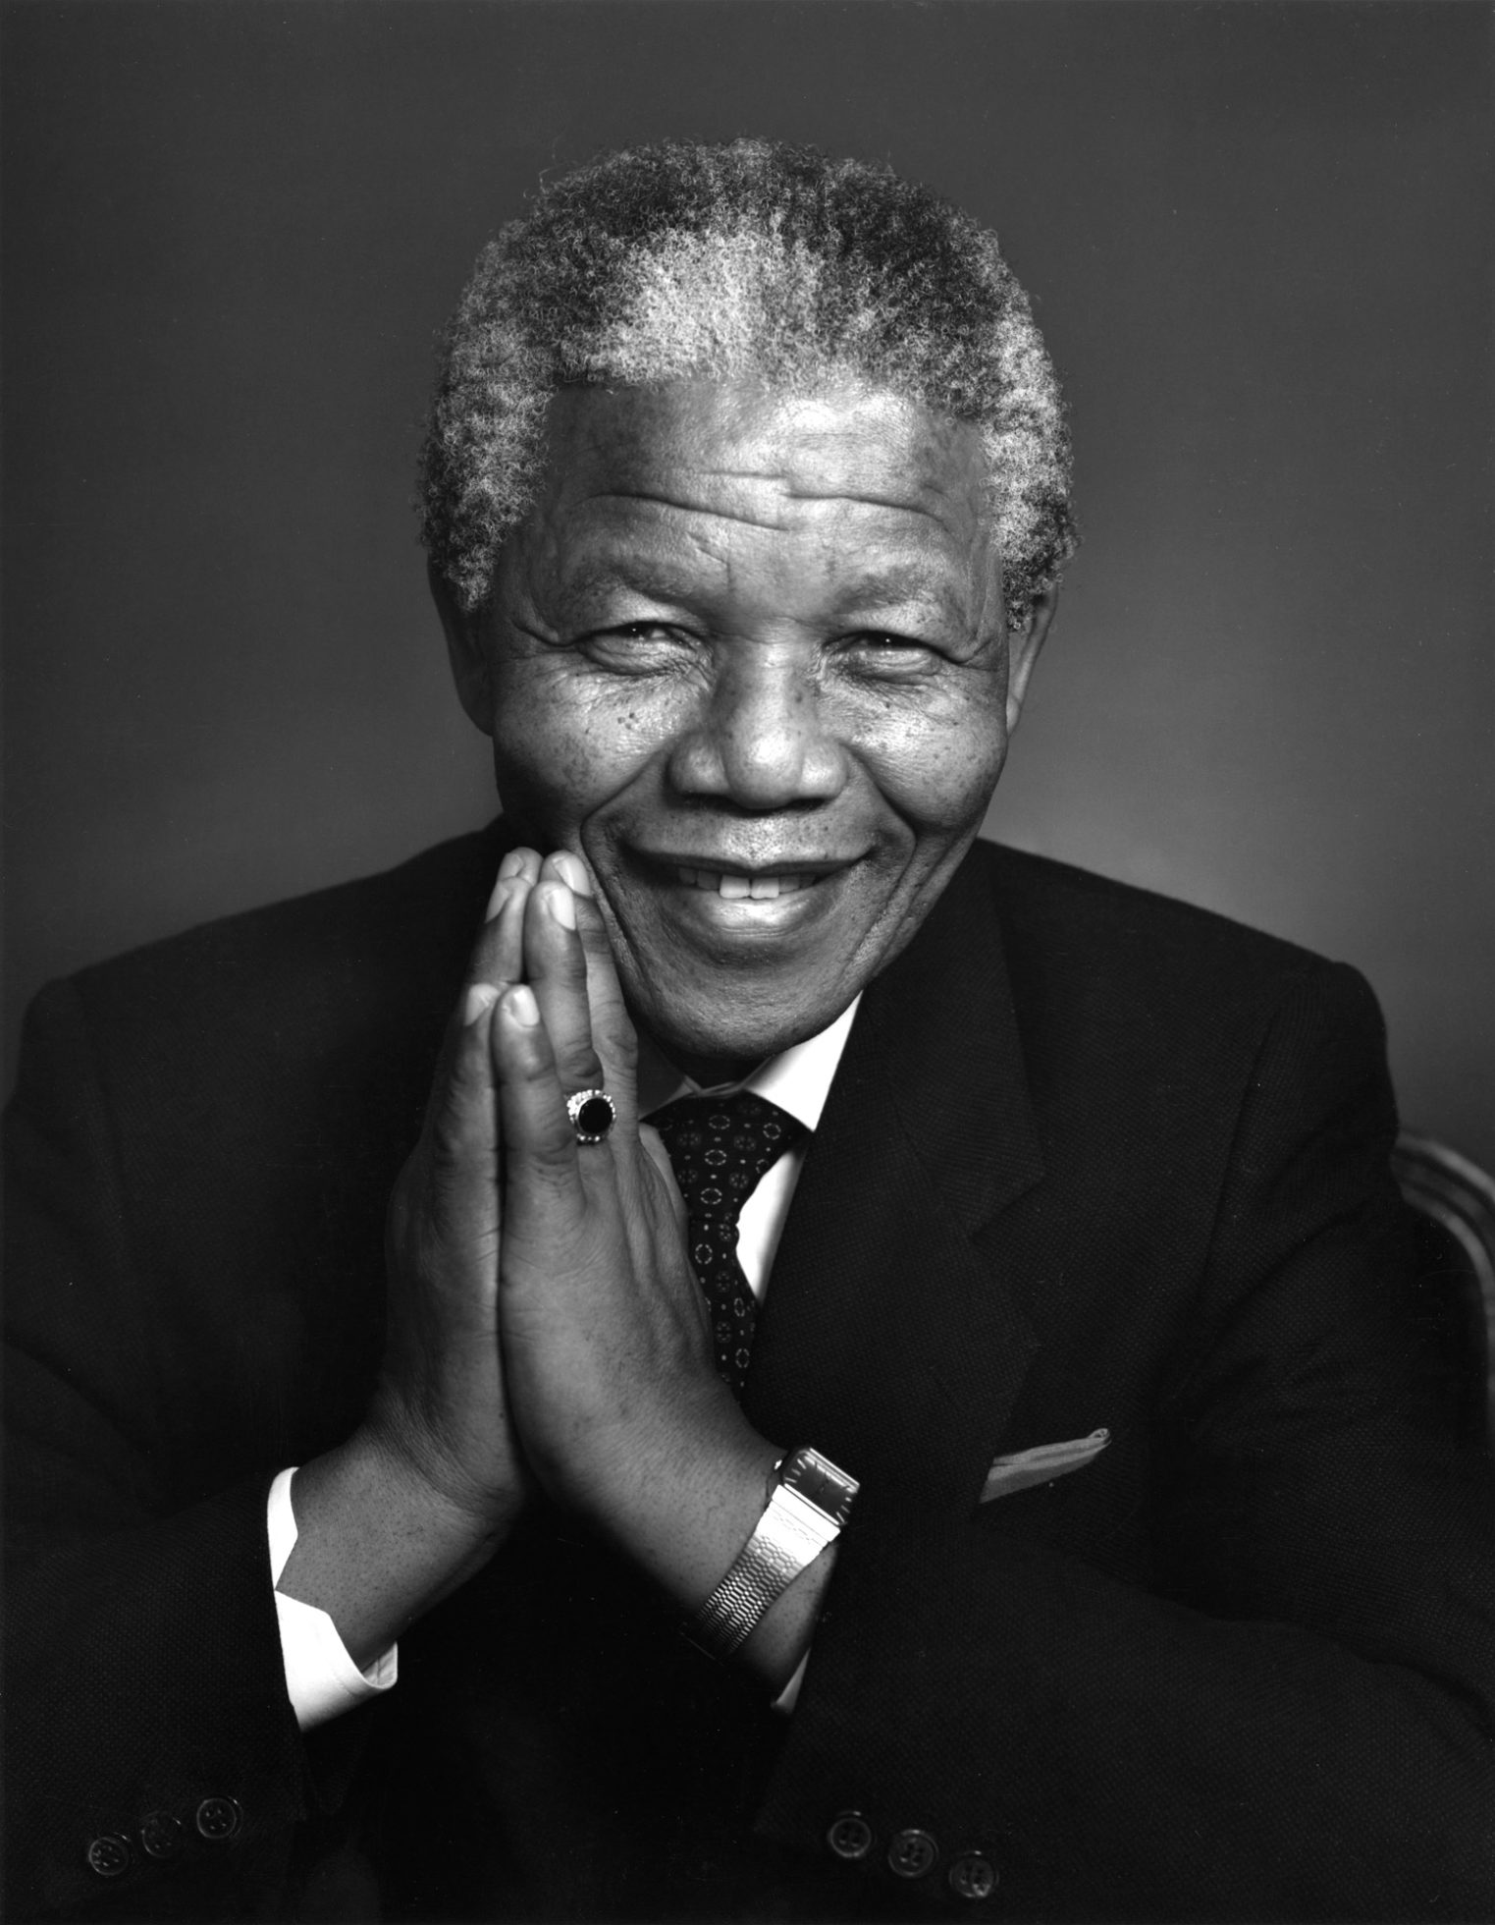
“Intelligence is the ability to adapt to change.”
Stephen Hawking
“There is nothing like returning to a place that remains unchanged to find the ways
in which you yourself have altered.”
Nelson Mandela

Slide 7
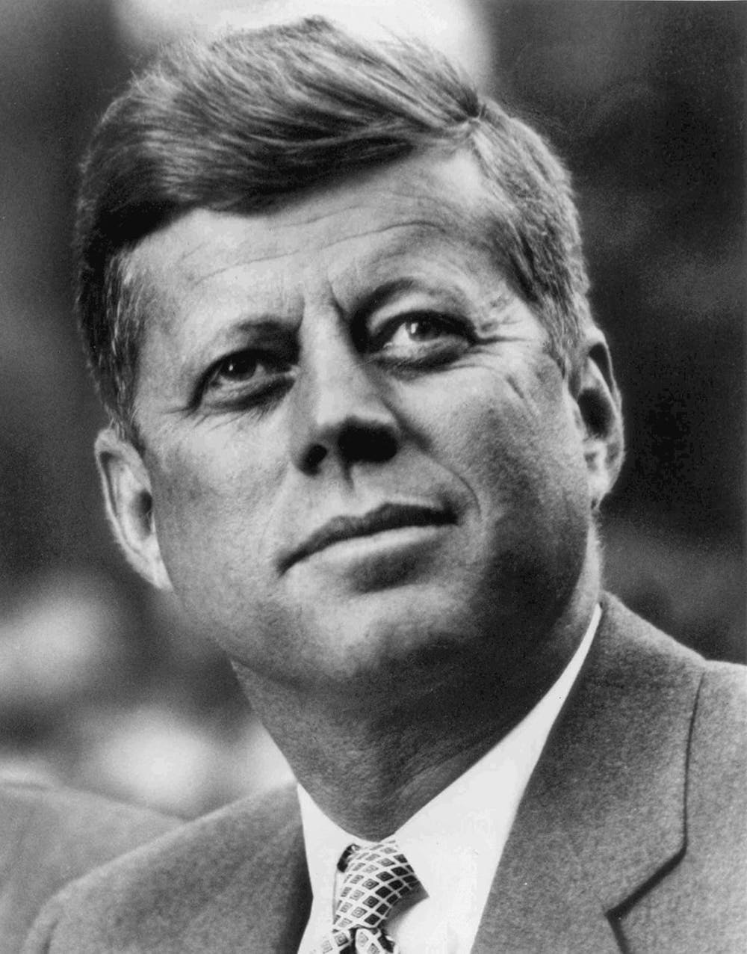
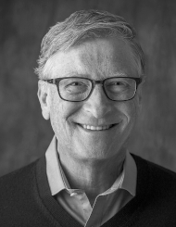
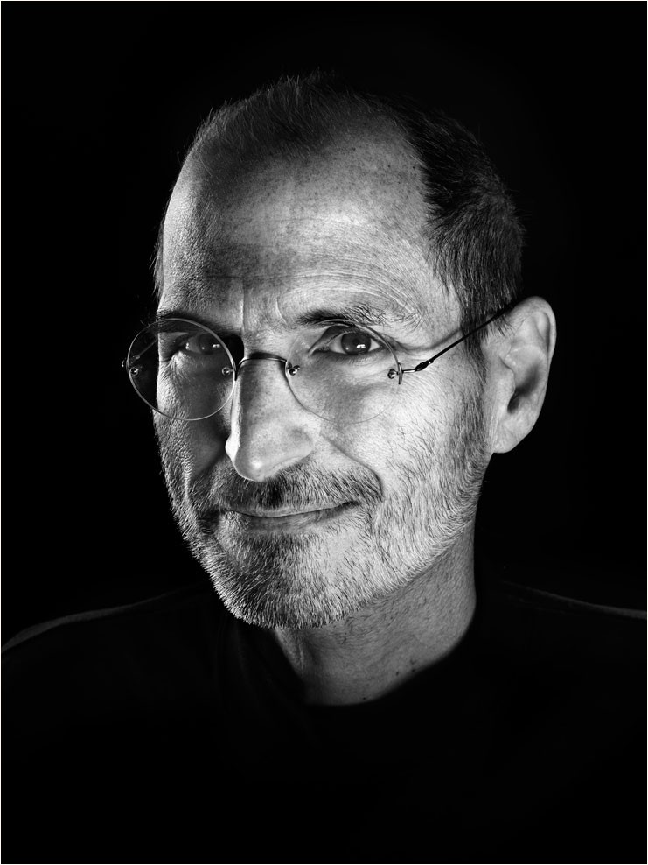
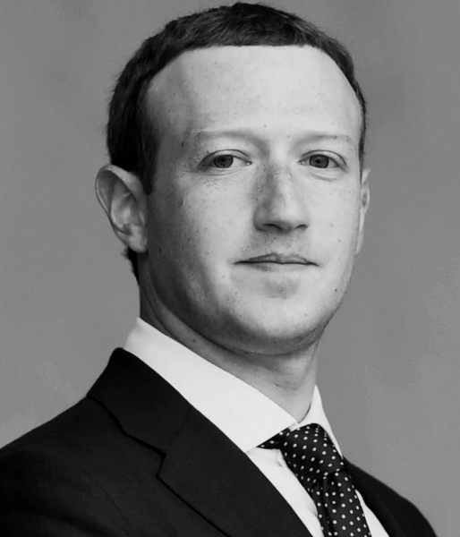
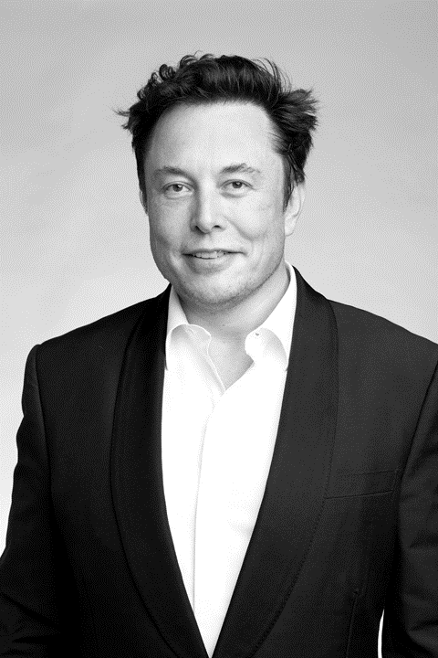
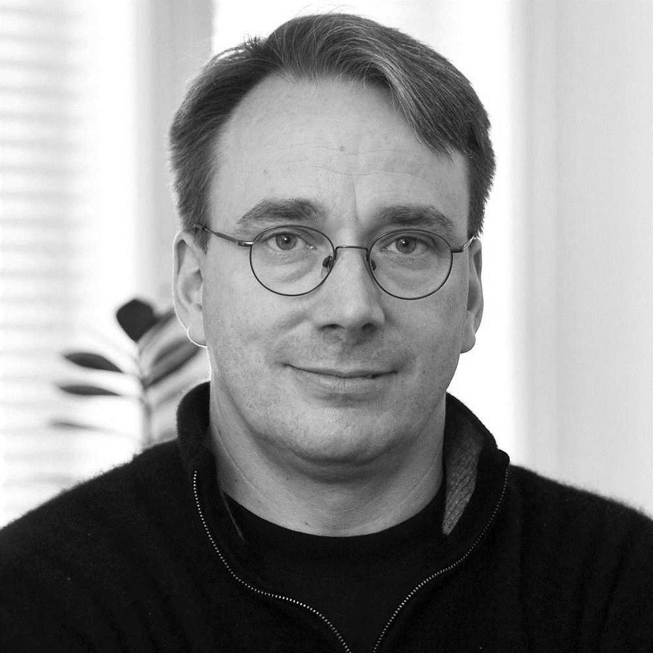
“We need men who can dream of things that never were.”
John F. Kennedy

Slide 8
OBRIGADO!

